Slide 1
Model1 and Model2
Details and Result

Slide 2
Model 1

Slide 3
Model 1(opening, building)
Use this model to detect openings and do building segmentation
Dataset:
Train：87 images from 24 segments
Val：18 images from 5 segments
Model: Mask RCNN with pretrained cityscape weight

Slide 4
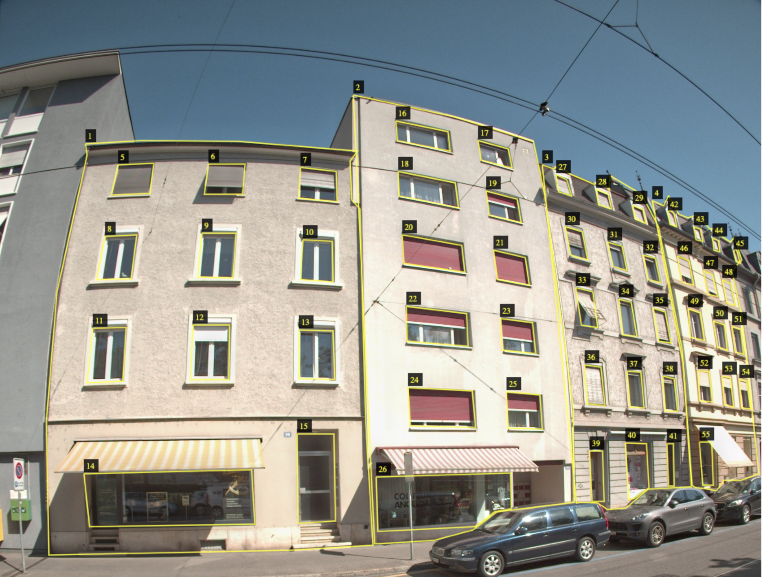
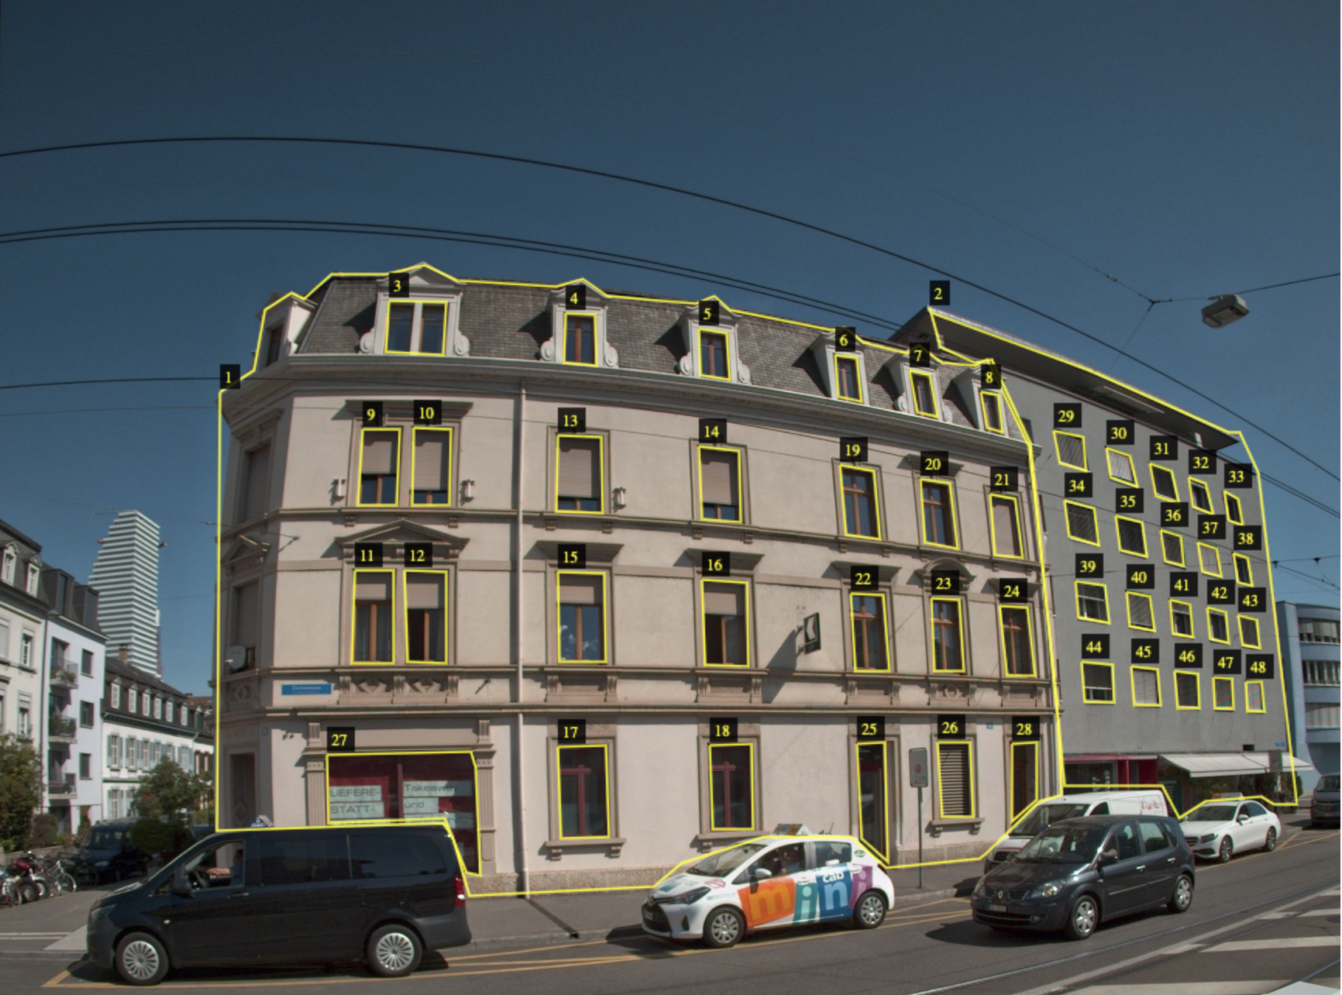
Train set annotation
Use VIA tool to annotate train set

Slide 5
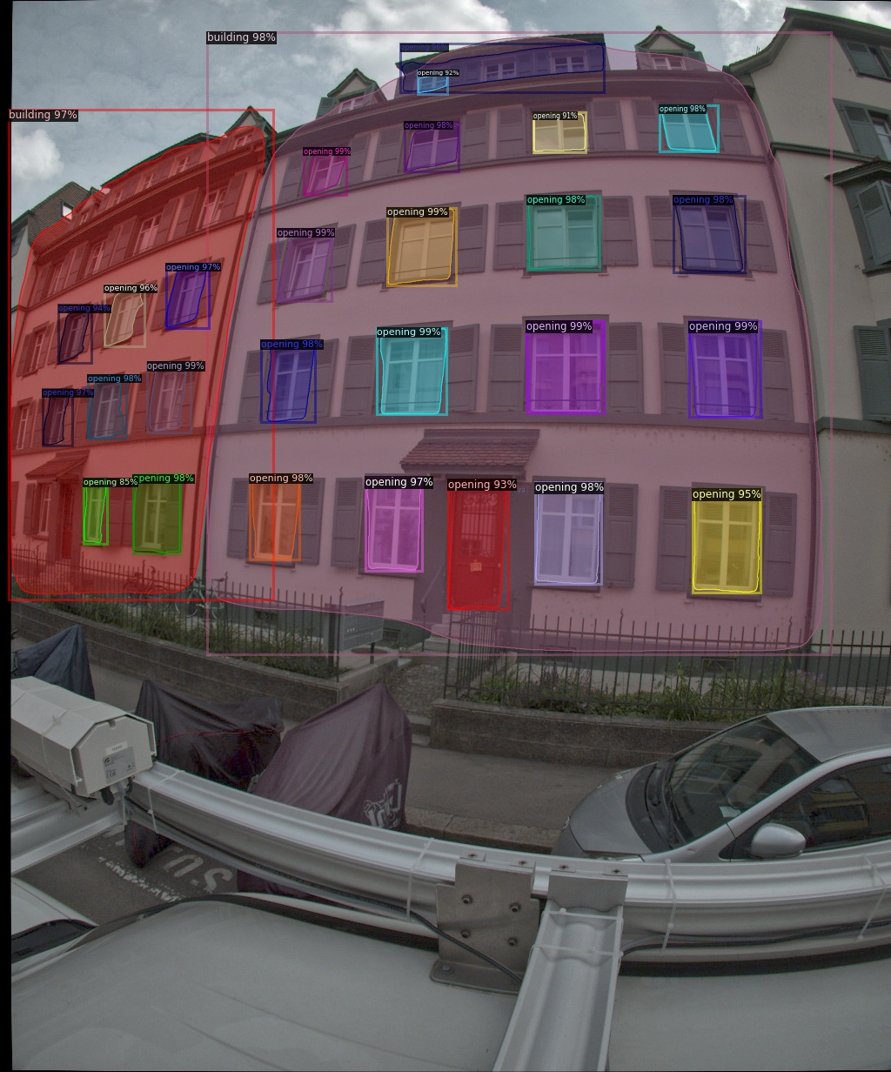
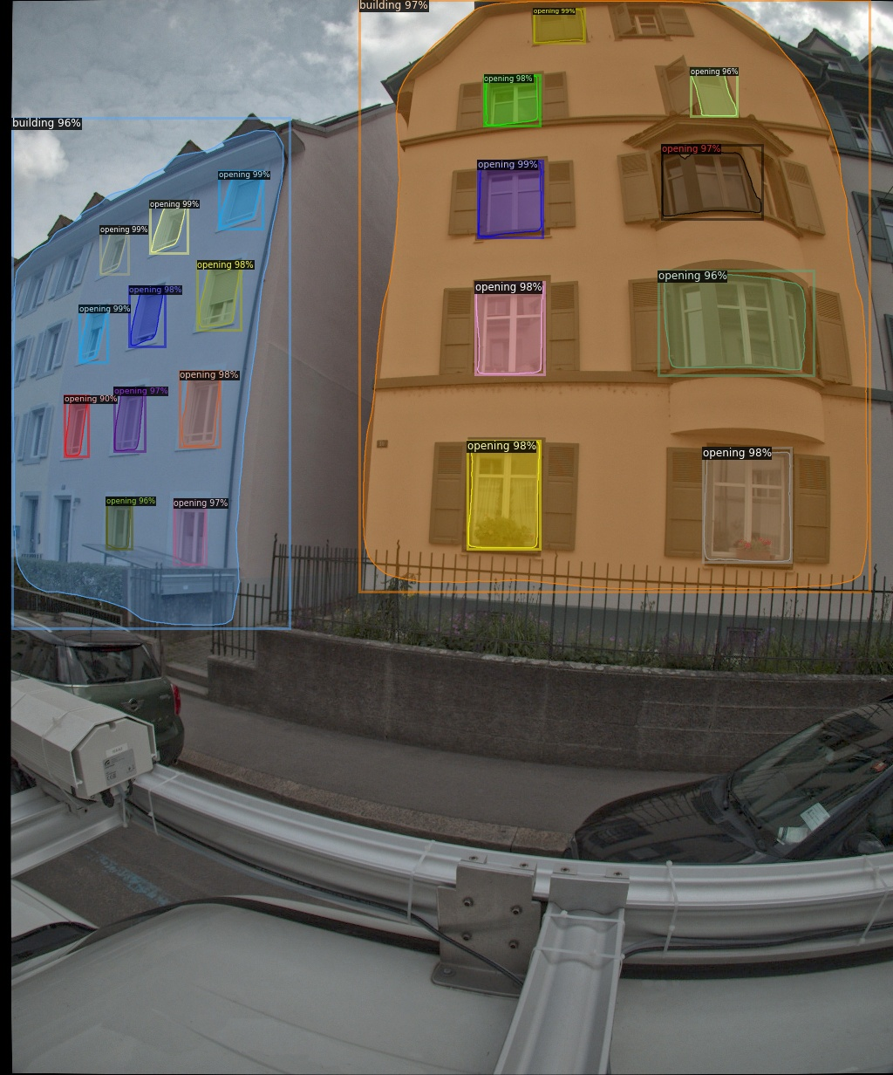
Val set prediction

Slide 6
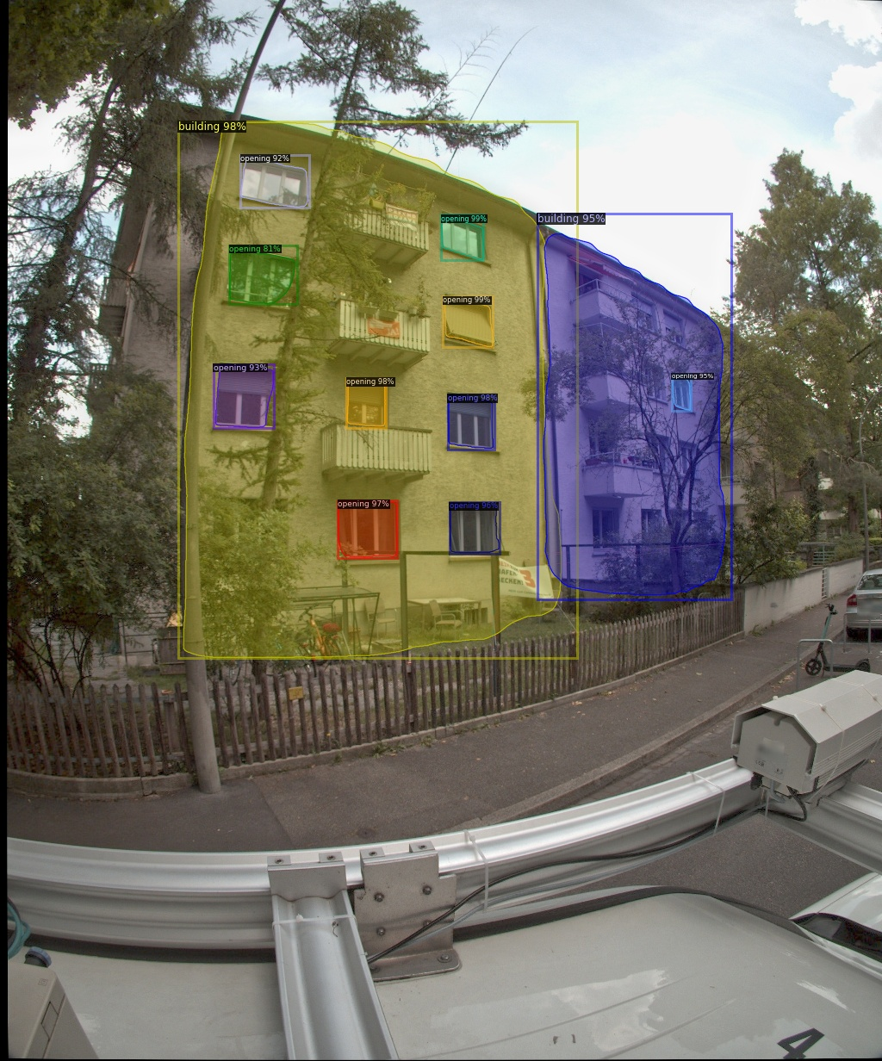
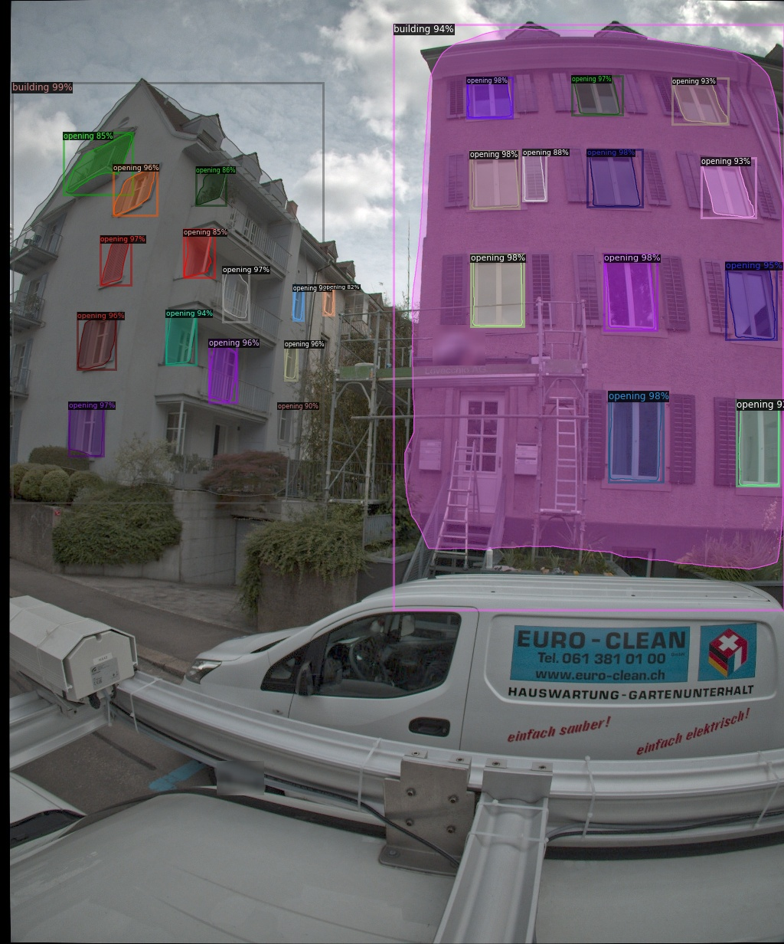
Val set prediction

Slide 7
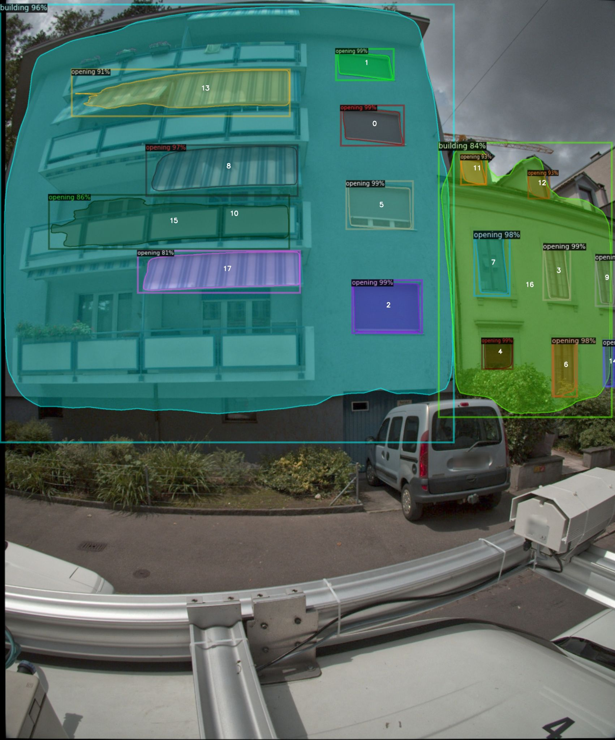
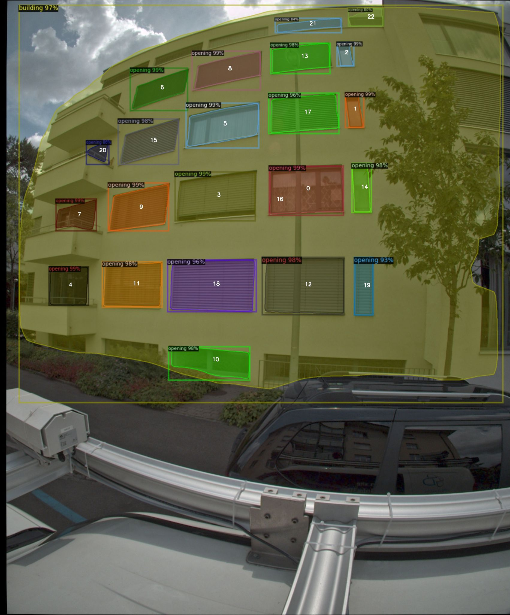
Test set (preform good)

Slide 8
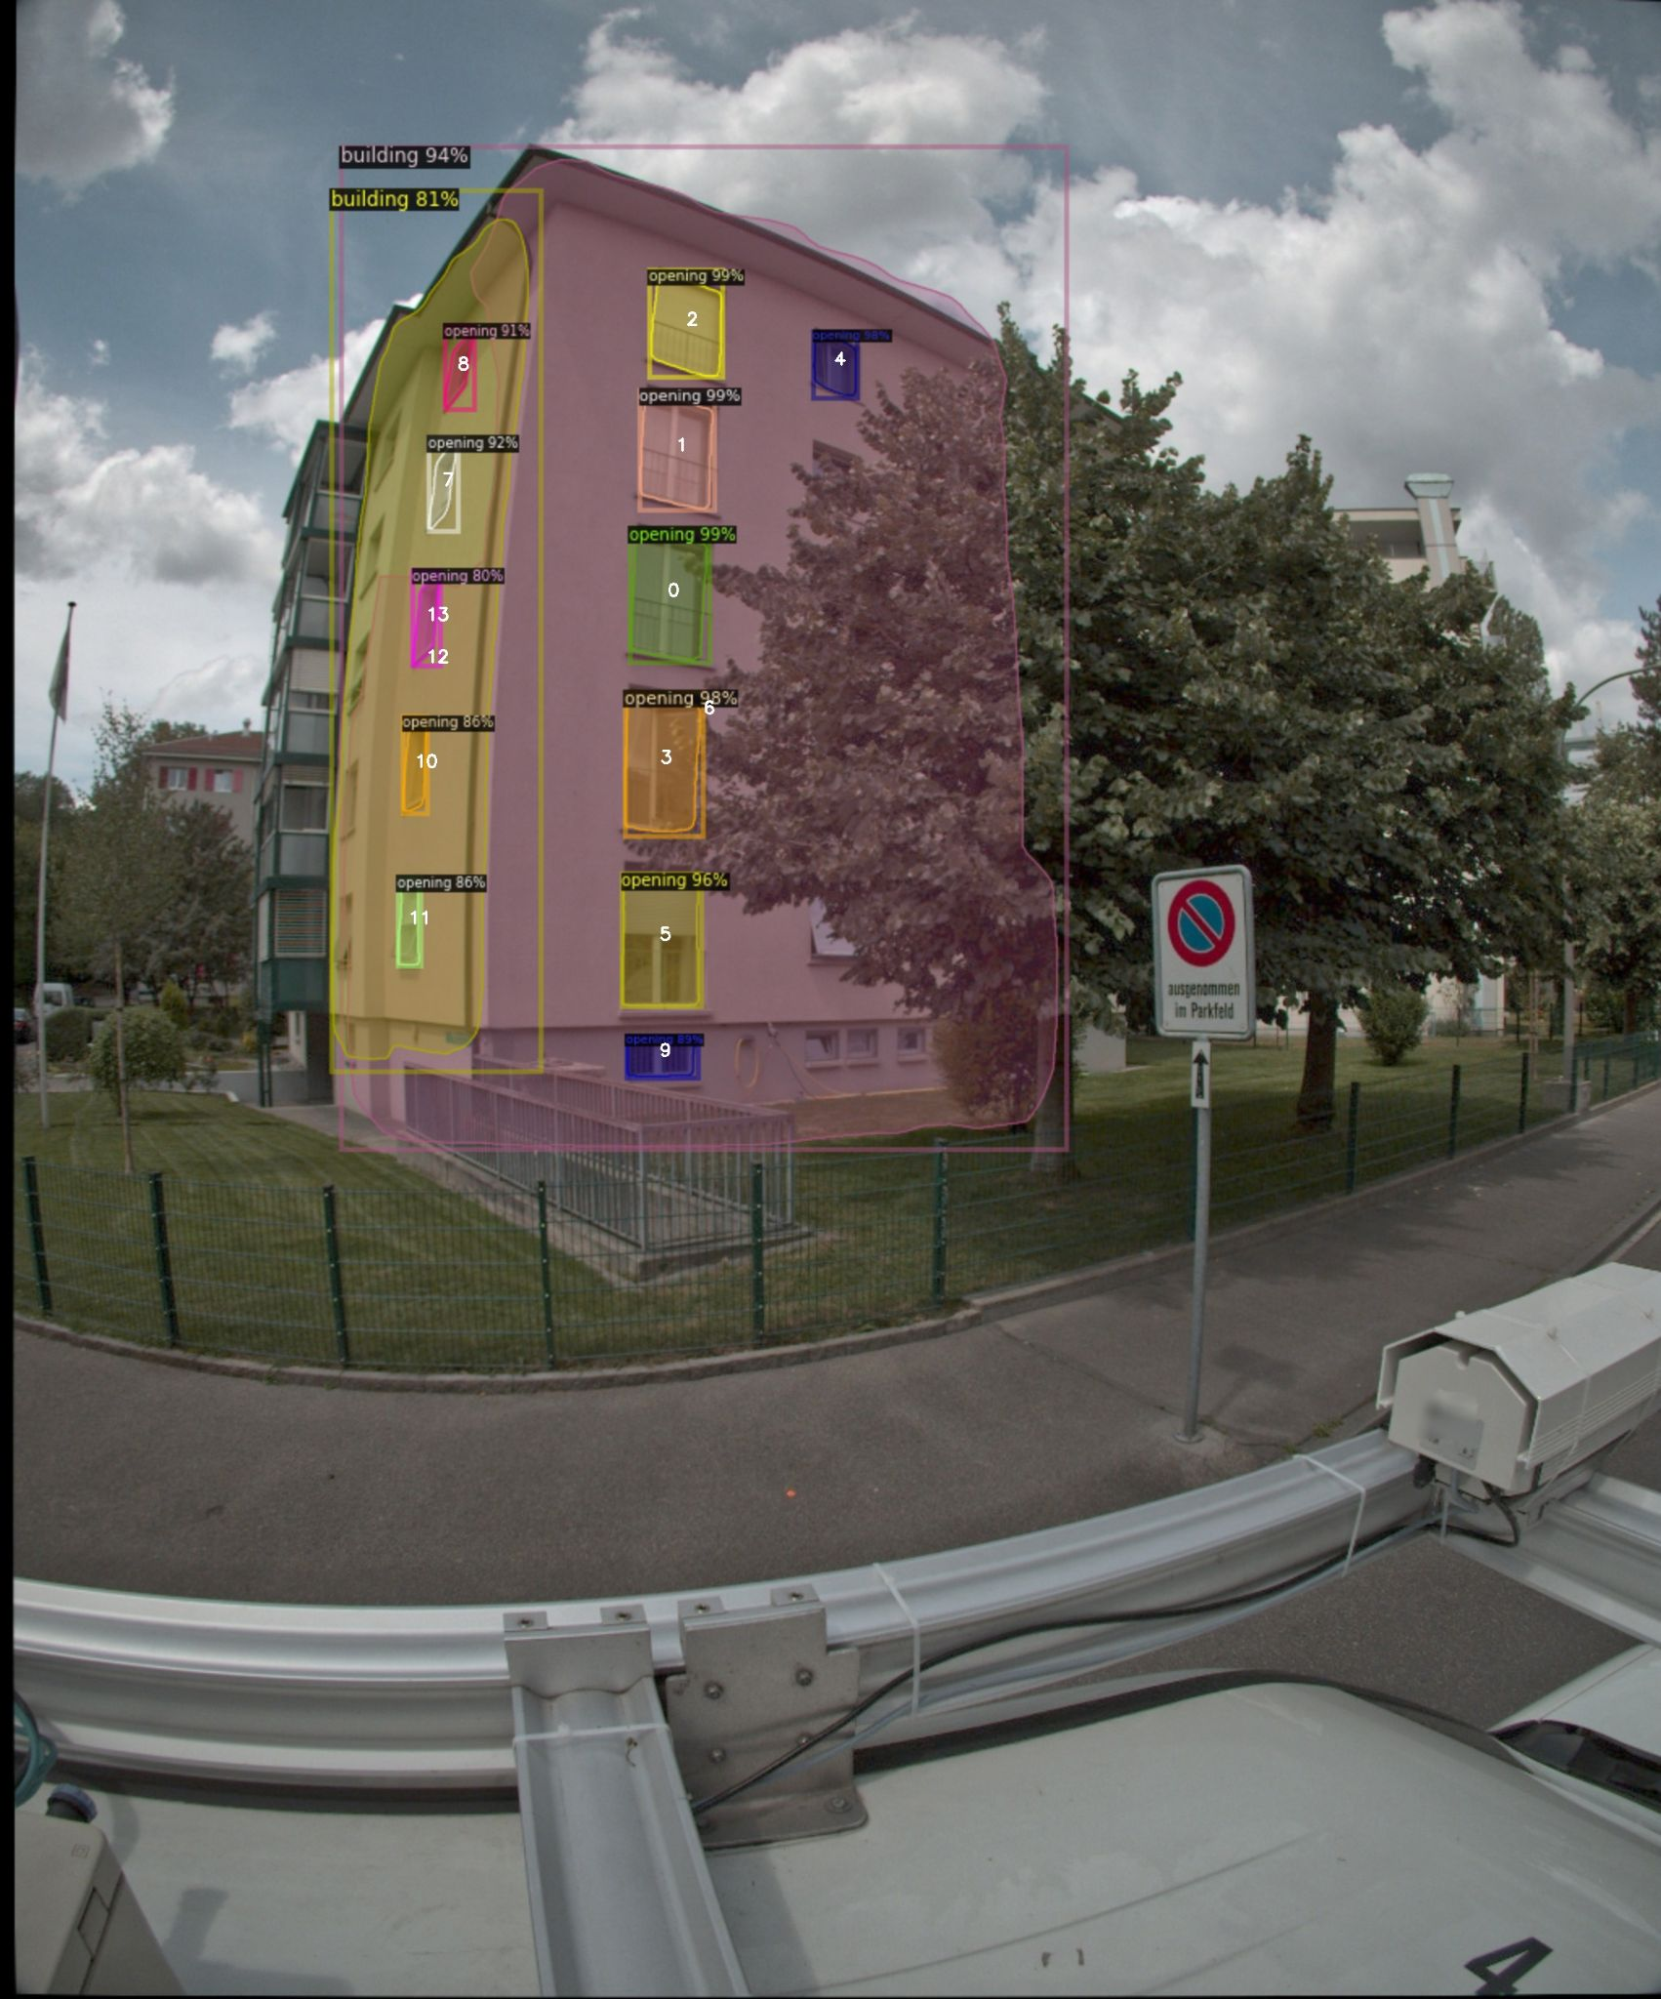
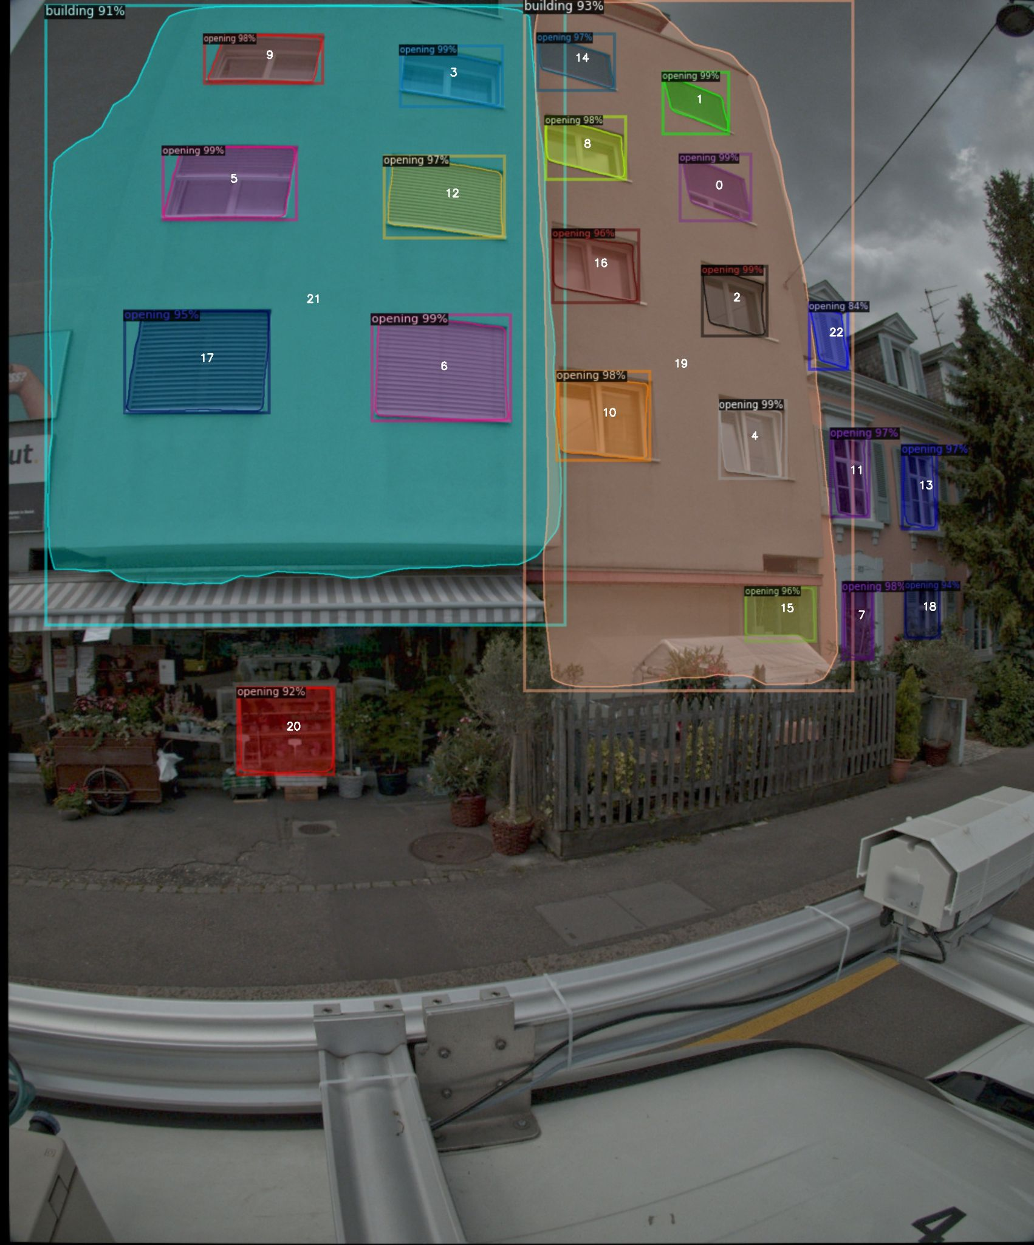
Test set (predict wrong)
Predict two facade as two building
Predict wrong
Notes:
16884_82144_22_4.jpg, Predict two facade as two building ;
16890_82150_9_4.jpg, One building separated into two parts

Slide 9
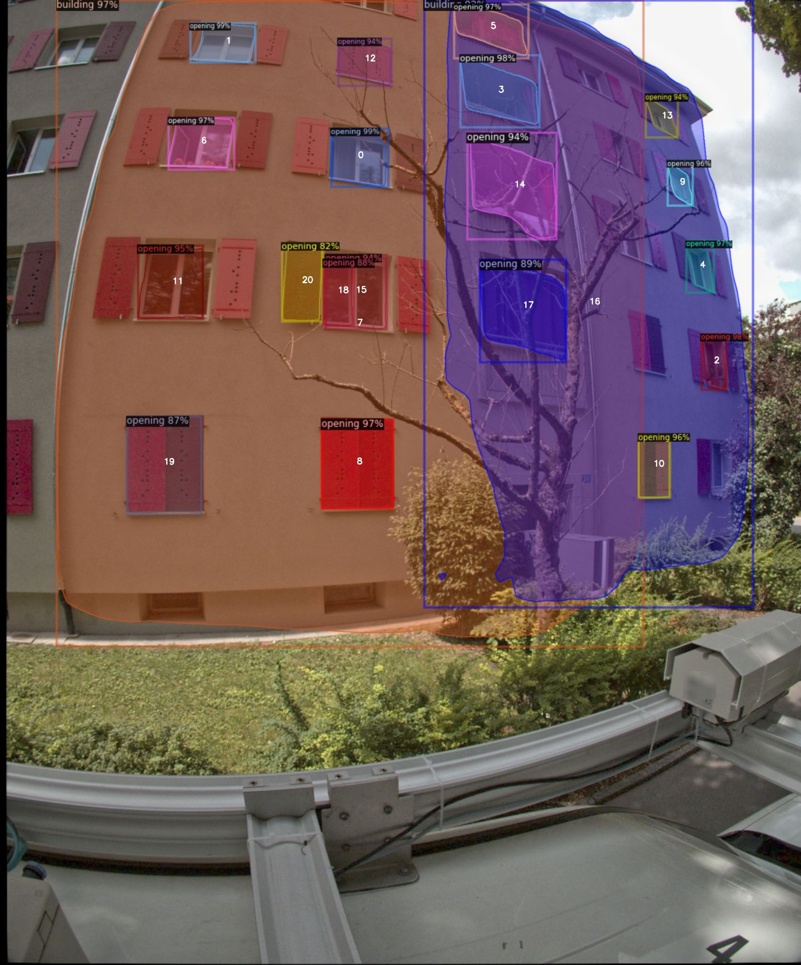
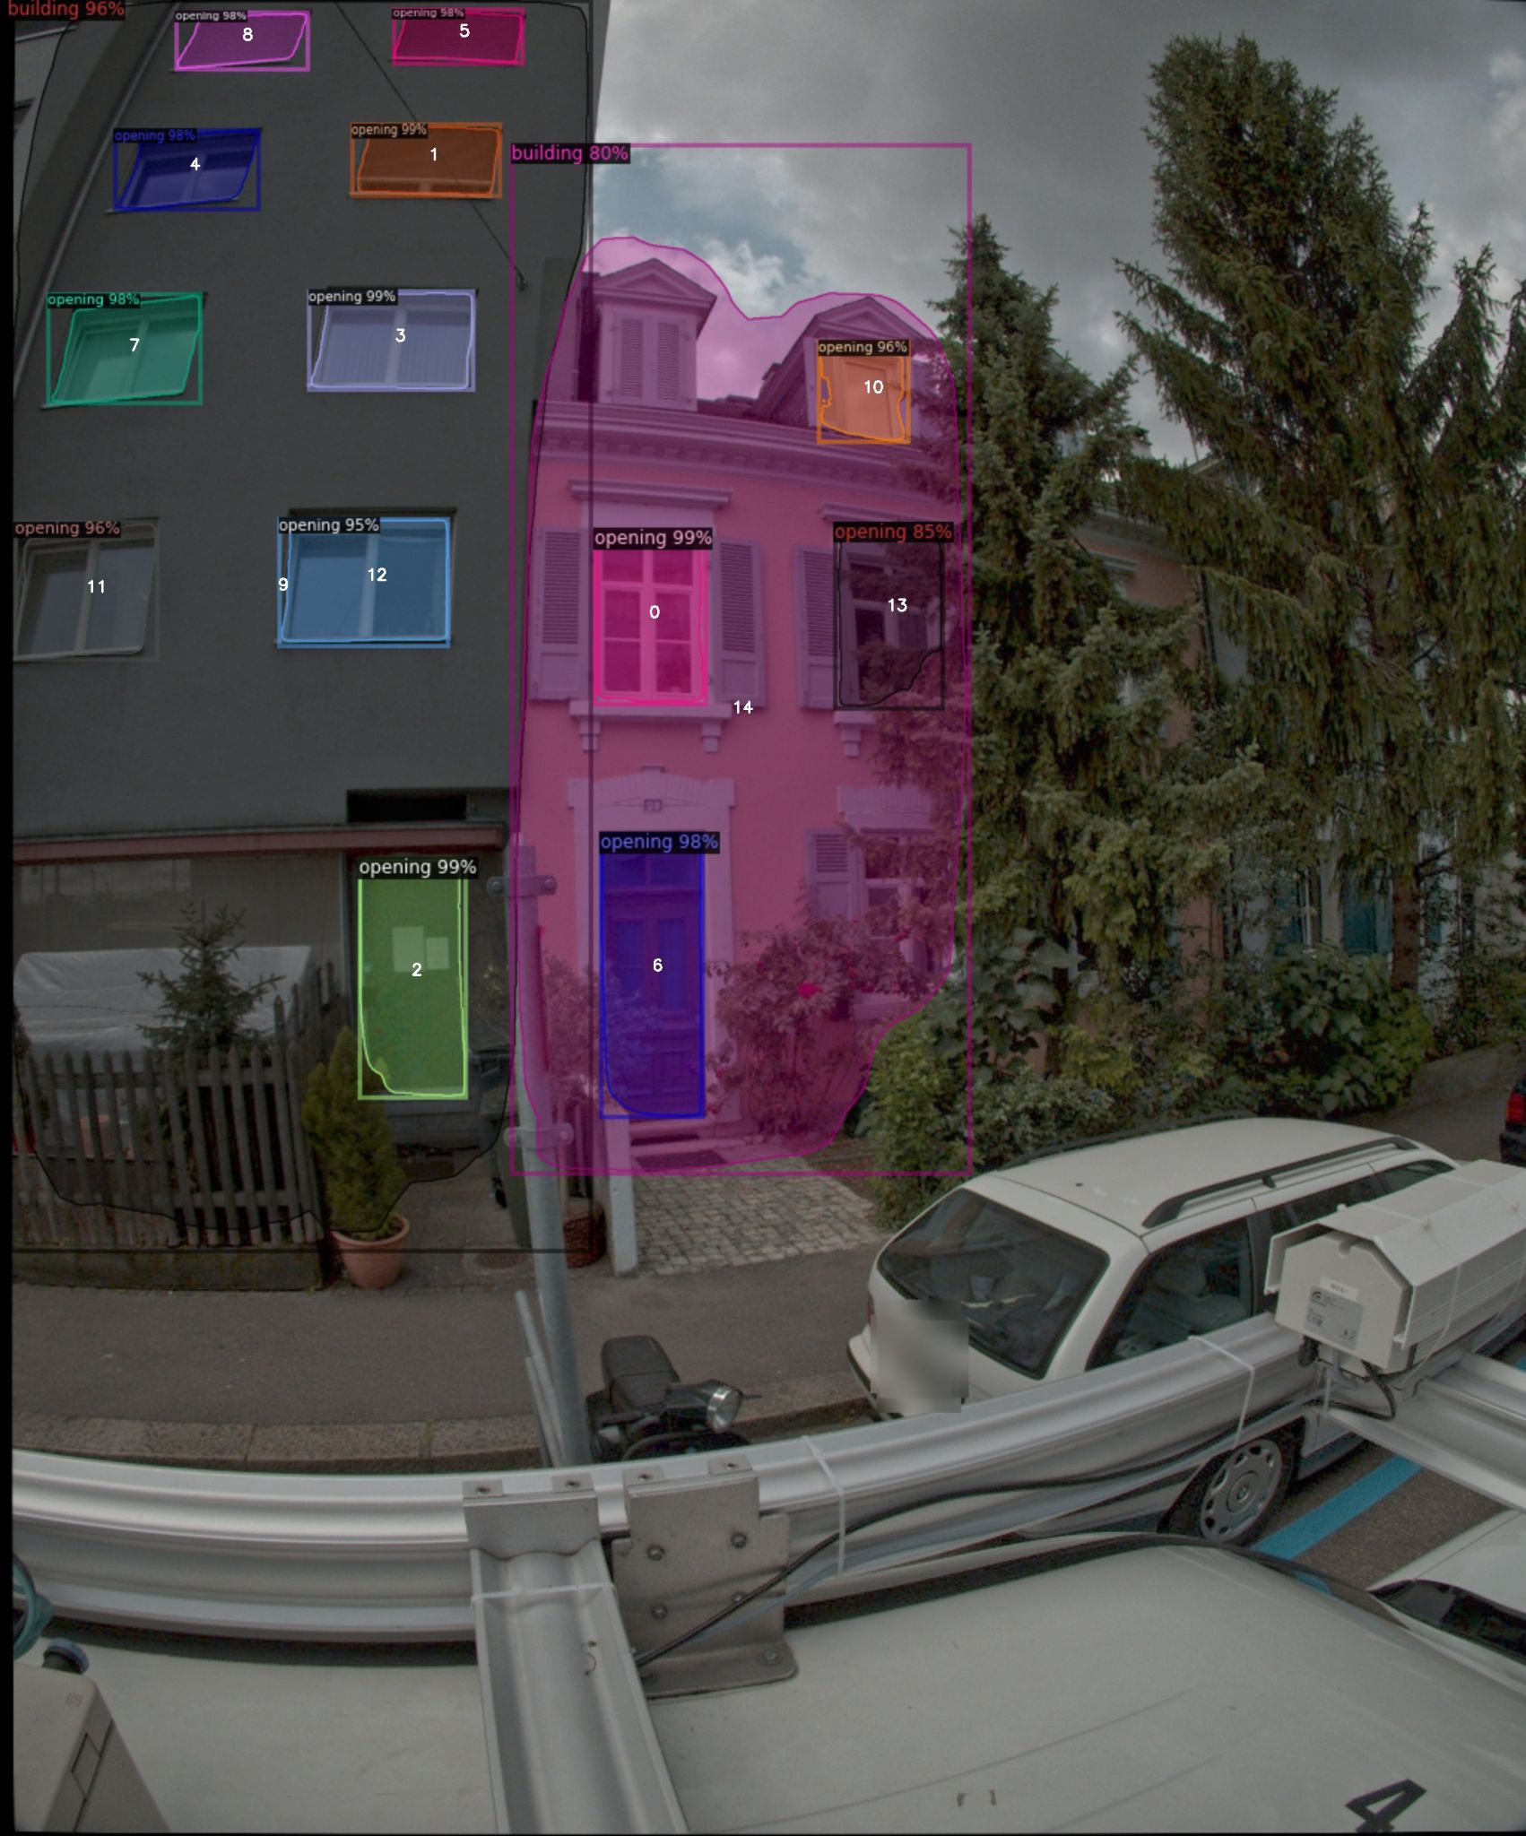
Test set (predict wrong)
Overlapping problem
Tree, cars, other kinds of noise
Notes:
16885_82145_30_4.jpg, Overlapping problem

Slide 10
Challenges
Duplication : there are many similar images taken in the same segment. In order to count building name, need to filter the duplication
Lack of annotated train dataset: there are only 87 train set images. larger dataset can get better result.
Overlapping: some parts are predicted to belong to two buildings, this problem may be solved if we have a larger train set since the model can learn more features

Slide 11
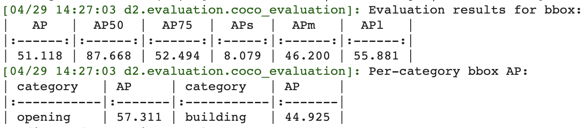
Evaluation
mean Average Precision(mAP) for val set. The mAP50 is 87% on val set, which is a good result.

Slide 12
Evaluation
Conditions of test set (if want to get good performance)
Only have front facade
A small area of trees, cars
Building not far from the camera
Most parts of buildings are taken into images (not small part )
Buildings that meet these conditions are called good quality buildings
The reason why we have these conditions is that we only consider selecting good quality buildings in the train set of model 1, and the model only learn from good quality buildings.
Add other kinds of building samples definitely will make model 1 become more robust

Slide 13
Model 2

Slide 14
Model 2 new (masonry, m6, rcw)
Use this model to predict building type
Dataset:
Train: 449 images ( 167 from Basel, 282 from Zurich)
Val: 96 images ( 27 from Basel , 59 from Zurich )
20 epoch, lr 0.00025

Slide 15
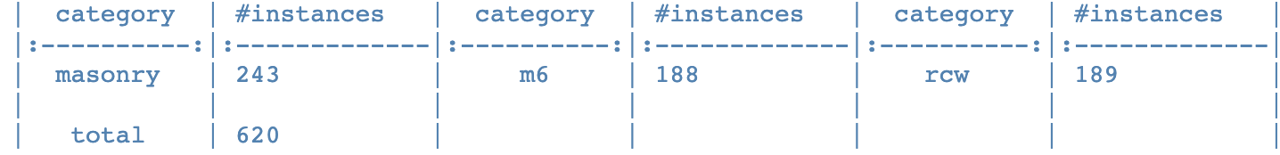
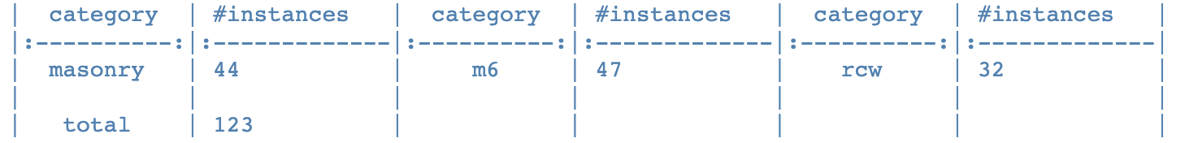
Instance distribution
Train set
Val set

Slide 16
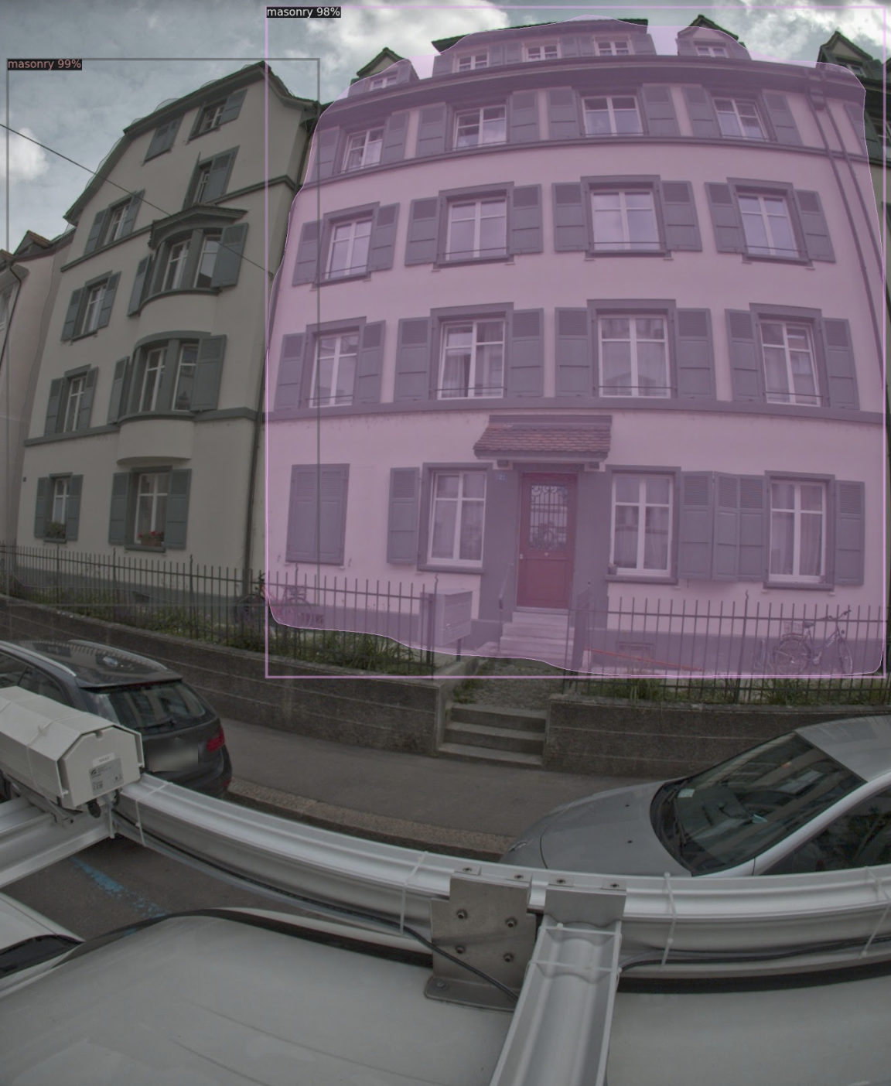
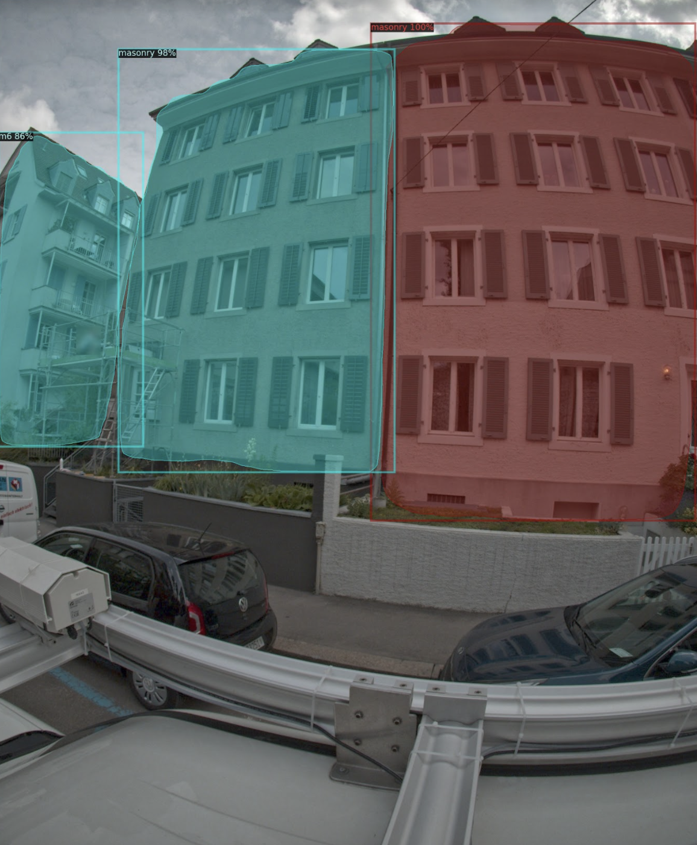
Model 2 Val set prediction

Slide 17
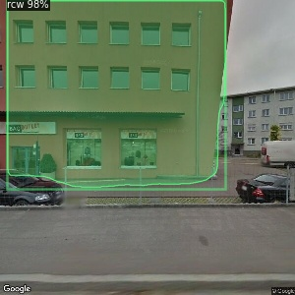
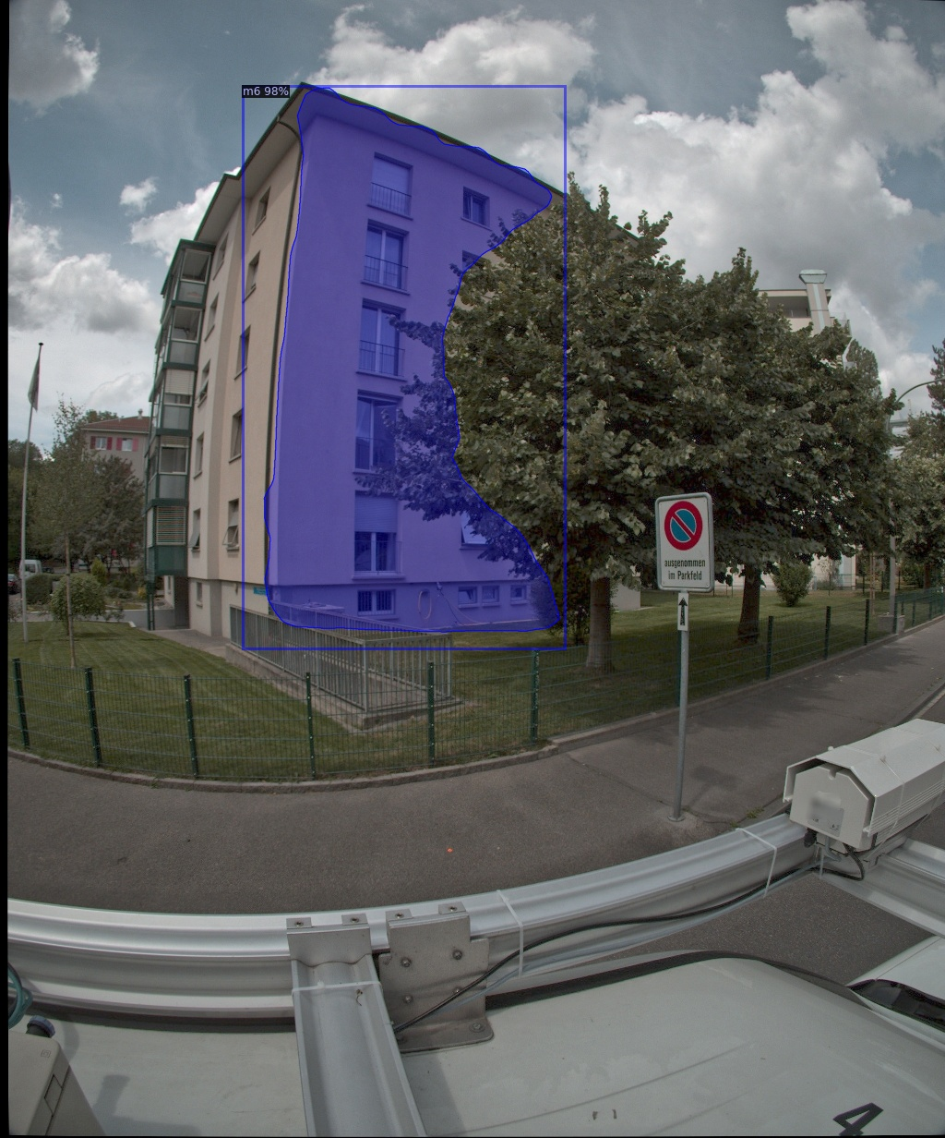
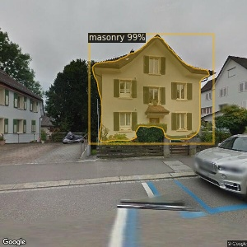
Val set prediction

Slide 18
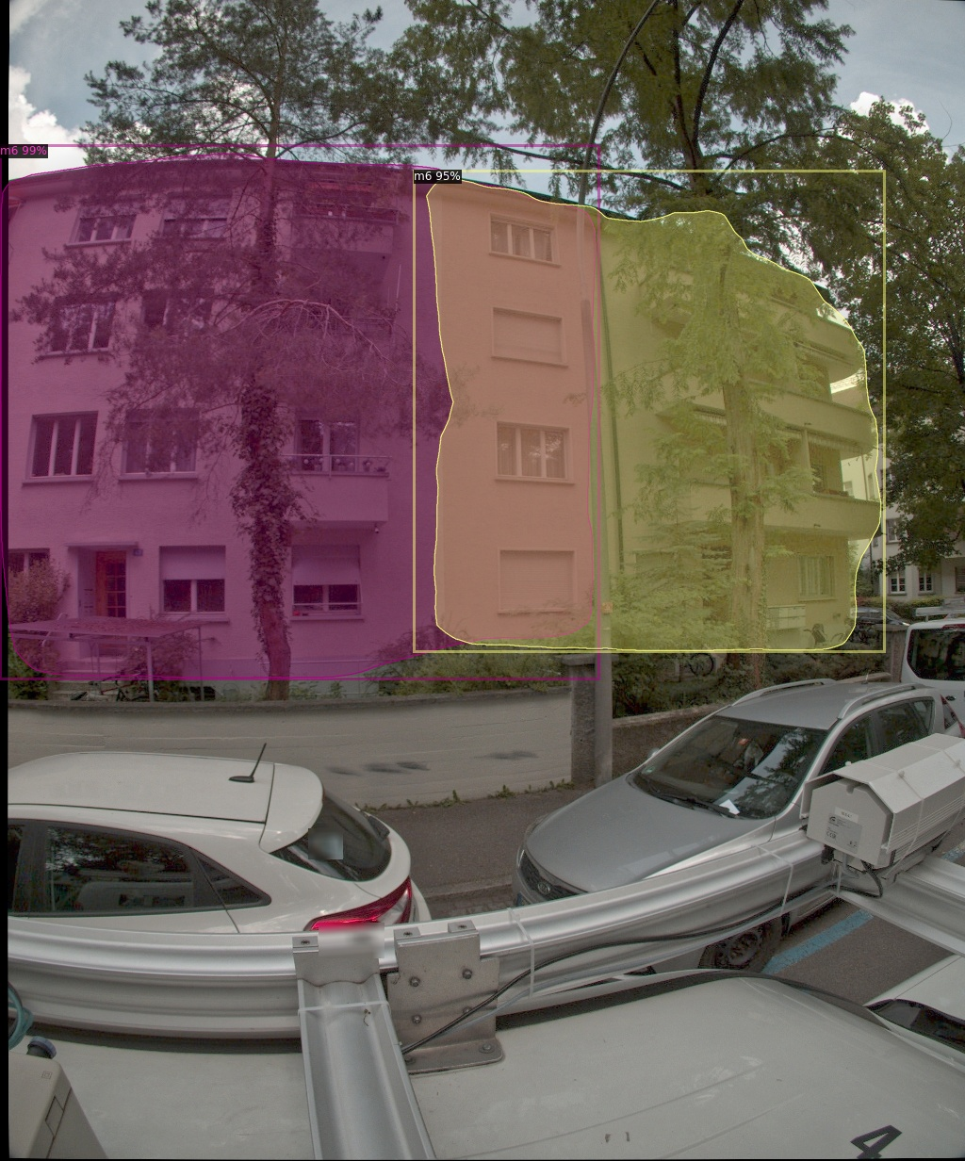
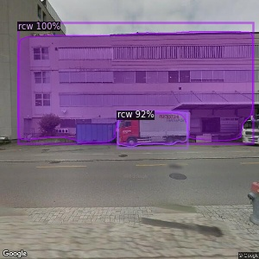
Wrong prediction
Car was recognized as rcw building
Overlapping problem, predicted building types are right

Slide 19
Challenges
Lack of samples: need expand train set to get more robust model
Overlapping: this problem may be solved by having larger train set, same as model 1

Slide 20
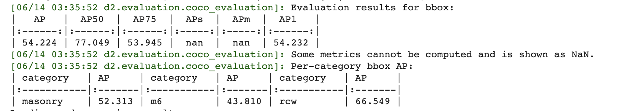
Evaluation
mean Average Precision(mAP) for val set. The mAP50 is 77% on val set

